Slide 1
CSE 207
Object Oriented Programming : Java

Slide 2
e
Graphics

Slide 3
Graphics class
Graphics class is an abstract class
Object can be obtained using getGraphics() method
Use import java.awt.Graphics

Slide 4
Example: Graphics class
JFrame frame=new JFrame();
JLabel banner=new JLabel("Banner");
frame.add(banner);
System.out.println(banner.getGraphics());
frame.setSize(400, 300);
frame.setVisible(true);
frame.setDefaultCloseOperation(JFrame.EXIT_ON_CLOSE);
JOptionPane.showMessageDialog(null,"Delay");
frame.getGraphics().drawLine(0, 0, 50, 50);

Slide 5
The paintComponent Method
Use to avoid graphics problems
To redraw the graphics the paintComponent() method is called automatically.

Slide 6
NOTE
Whenever a component is displayed, a Graphics object is created for the component. The Swing components use the paintComponent method to draw things. The paintComponent method is automatically invoked to paint the graphics context when the component is first displayed or whenever the component needs to be redisplayed. Invoking super.paintComponent(g) is necessary to ensure that the viewing area is cleared before a new drawing is displayed.

Slide 7
Example: paintComponent()
public class myInput {
public static void main(String[] args) {
JFrame frame=new JFrame();
JPanel panel=new JPanel();
frame.add(new NewPanel());
frame.setSize(400, 300);
frame.setVisible(true);
frame.setDefaultCloseOperation(
JFrame.EXIT_ON_CLOSE);
}
}
class NewPanel extends JPanel{
protected void paintComponent(Graphics g){
super.paintComponent(g);
g.drawLine(0,0,50,50);
g.drawString("Banner", 0, 40);
}
}

Slide 8
Drawing Geometric Figures
Drawing Lines
Drawing Rectangles
Drawing Ovals
Drawing Arcs
Drawing Polygons

Slide 9
Drawing Geometric Figures
Drawing Lines
Drawing Rectangles
Drawing Ovals
Drawing Arcs
Drawing Polygons

Slide 10
Drawing Lines
drawLine(x1, y1, x2, y2);

Slide 11
Drawing Rectangles
drawRect(x, y, w, h);
fillRect(x, y, w, h);

Slide 12
Drawing Rounded Rectangles
drawRoundRect(x, y, w, h, aw, ah);
fillRoundRect(x, y, w, h, aw, ah);

Slide 13
Drawing Ovals
drawOval(x, y, w, h);
fillOval(x, y, w, h);

Slide 14
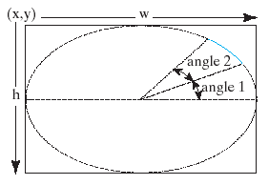
Drawing Arcs
drawArc(x, y, w, h, angle1, angle2);
fillArc(x, y, w, h, angle1, angle2);

Slide 15
Drawing Polygons
int[] x = {40, 70, 60, 45, 20};
int[] y = {20, 40, 80, 45, 60};
g.drawPolygon(x, y, x.length);
g.fillPolygon(x, y, x.length);

Slide 16
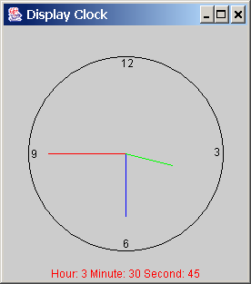
Drawing a Clock
Objective: Use drawing and trigonometric methods to draw a clock showing the specified hour, minute, and second in a frame.

Slide 17
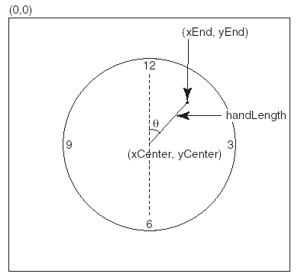
Drawing Clock
xEnd = xCenter + handLength × sin(θ)
yEnd = yCenter - handLength × cos(θ)
Since there are sixty seconds in one minute, the angle for the second hand is
second × (2π/60)

Slide 18
Drawing Clock, cont.
xEnd = xCenter + handLength × sin(θ)
yEnd = yCenter - handLength × cos(θ)
The position of the minute hand is determined by the minute and second. The exact minute value comined with seconds is minute + second/60. For example, if the time is 3 minutes and 30 seconds. The total minutes are 3.5. Since there are sixty minutes in one hour, the angle for the minute hand is
(minute + second/60) × (2π/60)

Slide 19
Drawing Clock, cont.
xEnd = xCenter + handLength × sin(θ)
yEnd = yCenter - handLength × cos(θ)
Since one circle is divided into twelve hours, the angle for the hour hand is
(hour + minute/60 + second/(60 × 60))) × (2π/12)

Slide 20
to

